Slide 1


A PROJECT WORK
PRESENTED BY
- EXAMINER: Er.KAMAL LEKHAK
BIPESH KHADKA
NAGENDRA JOSHI
KABITA CHAND
NEELAM BOHARA

Slide 2
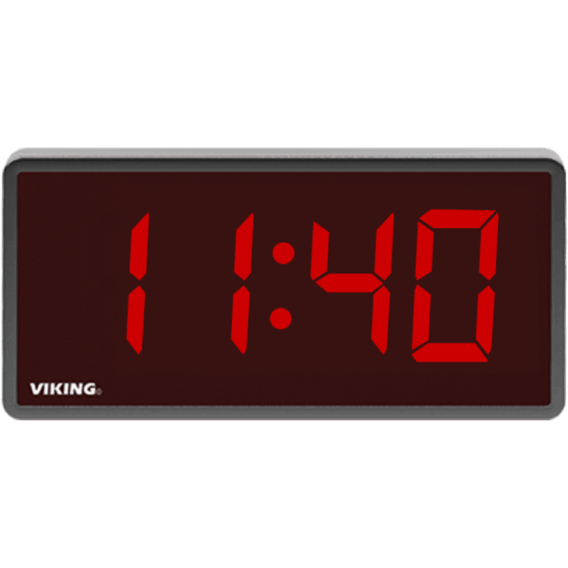
Introduction
Digital clock are the electronic devices that directly display the time.
it works on 12 or 24 hours format.
These clock are widely use in household, machines set and other electronic components that relay or operated on certain intervals.
These clocks are constructed using the logic gates and the counters that count the stable signal and display the output to the screen.
These pulses are used to synchronize the operation of various digital circuits or devices.

Slide 3
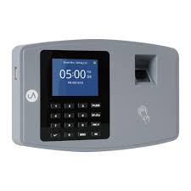
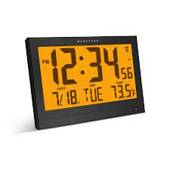
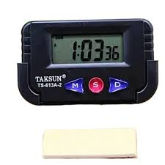
Applications of digital clock
Since digital clock are easy to read so they are use in most of the device for the operations like automatic and time setting works.

Slide 4
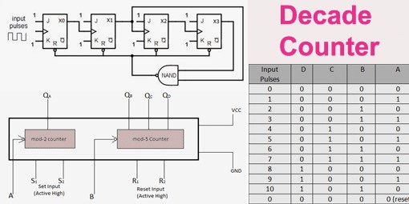
Components
Counters
A decade counter is a binary counter designed to count to 1001 (decimal 9) which that counts the digits.
There are some available ICs for decade counters which we can readily use in our circuit, like 74LS90.
An ordinary four-stage counter can be easily modified to a decade counter by adding a NAND gate as in the schematic to the right.
It requires 4 flip-flops to construct a decade counter which is constructed with JK flip flop.
The J output and K outputs are connected to logic 1 whose diagram is shown here.

Slide 5
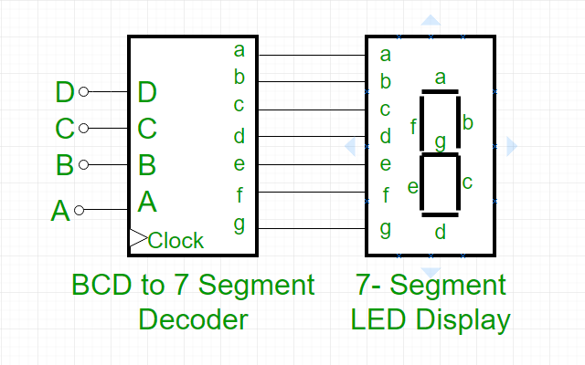
BCD to 7-Segment Decoder
it is a special decoder which can convert BCD into another form which can be easily displayed through a 7-segment display.
This has four input lines (A, B, C and D) and 7 output lines (a, b, c, d, e, f and g).
Those output are passed to 7 segment display to display the correct output.
We have use a 4677 decoder in the simulation of digital clock.

Slide 6
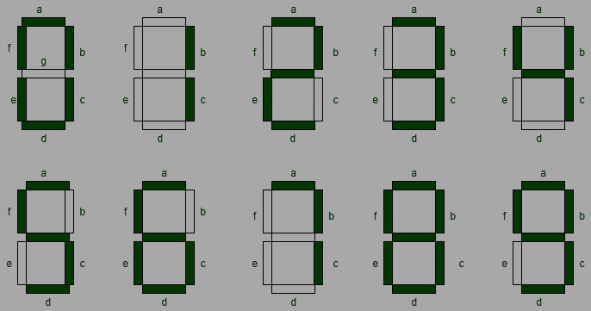
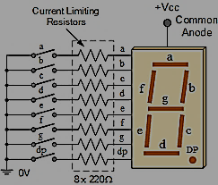
SEVEN SEGMENT DISPLAY
Seven segment display is a digital device used for displaying decimal numbers alphabets and characters.
It contains seven led segment arranged in a given fig.
It is widely used in digital clocks, basic calculators, electronic meters

Slide 7
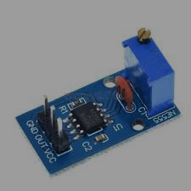
Clock pulse generator
The clock pulse generator produces a precise and stable clock signal. The clock signal synchronizes the operation of all components. The accuracy of this signal is crucial for timekeeping accuracy.

Slide 8
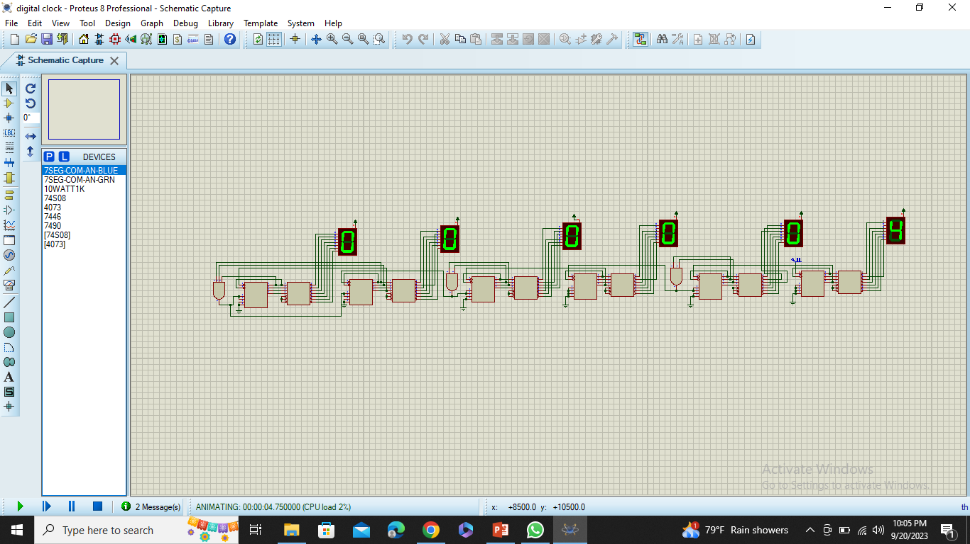
WORKING PRINCIPLE OF DIGITAL CLOCK
Analyses the format of digital clock going to be designed 24 hrs. or 12 hrs.
We uses two counters, decoder and 7 segment display for each parts of time hours, second and minutes
The clock signal was supplied through clock pulse.
Using the logic gate the reset and clock were triggered in minute and hours respectively as clock works.

Slide 9
CONCLUSION
After all studying the digital circuit and having the knowledge of circuits and different components like flipflop, counters, decoder, multiplexer and many other digital component. We use this knowledge through what we learn in the project for the designed of digital clock using the logic gates and these components is to create functional, accurate, user-friendly device. Overcoming technical challenges, meeting safety standards and scalability, we designed a digital clock that has been tested and successfully implemented. In general, this project has been successfully carried out and satisfies the overall aim and objectives of the project. In this project, we learned time management and teamwork with the basic circuit simulation in circuit construction.
.

Slide 10


Slide 11
Thank you
thank you for your time and attention toward our words and hard work.

